Slide 1
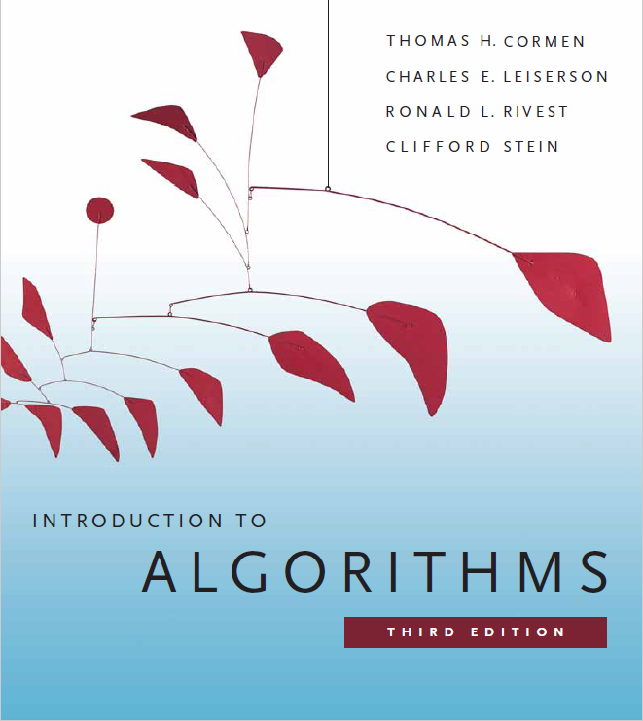
Elementary Data Structures
Prepared by Shmuel Wimer
Instructed by Deganit Armon and Shmuel Wimer

Slide 2
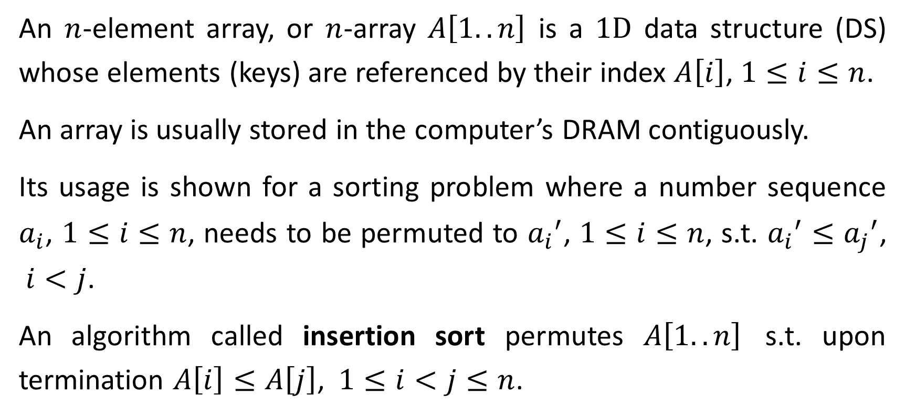
Arrays
An $n$-element array, or $n$-array $A\left[1..n\right]$ is a $\text{1}\text{D}$ data structure (DS) whose elements (keys) are referenced by their index $A\left[i\right]$, $1≤i≤n$.
An array is usually stored in the computer’s DRAM contiguously.
Its usage is shown for a sorting problem where a number sequence $a_{i}$, $1≤i≤n$, needs to be permuted to ${a_{i}}^{′}$, $1≤i≤n$, s.t. ${a_{i}}^{′}≤{a_{j}}^{′}$, $i<j$.
An algorithm called insertion sort permutes $A\left[1..n\right]$ s.t. upon termination $A\left[i\right]≤A\left[j\right]$, $1≤i<j≤n$.

Slide 3
1 | 2 | 3 | 4 | 5 | 6
1 | 2 | 3 | 4 | 5 | 6
5 | 2 | 4 | 6 | 1 | 3
2 | 5 | 4 | 6 | 1 | 3
CV
1 | 2 | 3 | 4 | 5 | 6
1 | 2 | 3 | 4 | 5 | 6
2 | 4 | 5 | 6 | 1 | 3
2 | 4 | 5 | 6 | 1 | 3
CV
1 | 2 | 3 | 4 | 5 | 6
1 | 2 | 3 | 4 | 5 | 6
1 | 2 | 4 | 5 | 6 | 3
1 | 2 | 3 | 4 | 5 | 6
CV

Slide 4
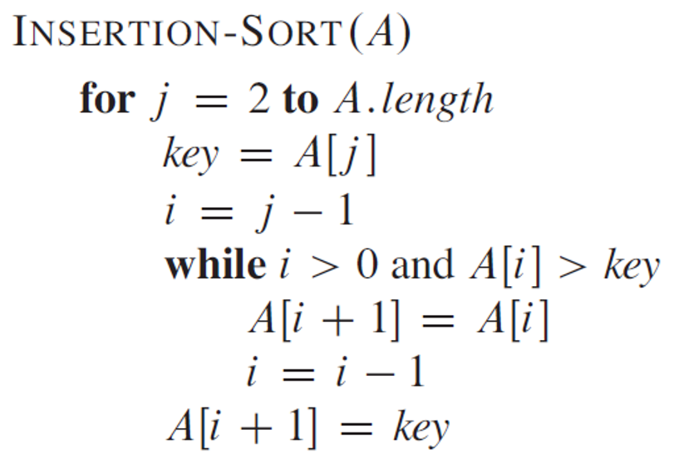
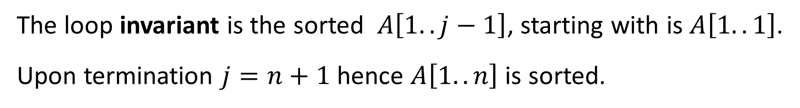
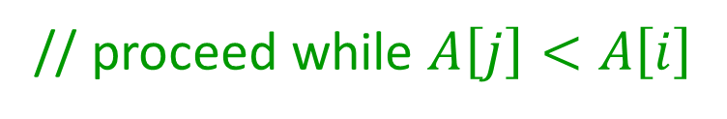
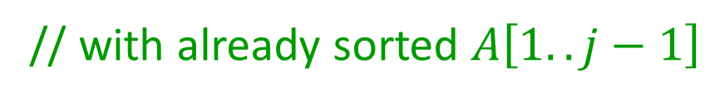
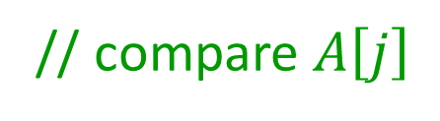
// compare $A\left[j\right]$
// with already sorted $A\left[1..j−1\right]$
// proceed while $A\left[j\right]<A\left[i\right]$
// swap keys
The loop invariant is the sorted $A\left[1..j−1\right]$, starting with is $A\left[1..1\right]$.
Upon termination $j=n+1$ hence $A\left[1..n\right]$ is sorted.

Slide 5
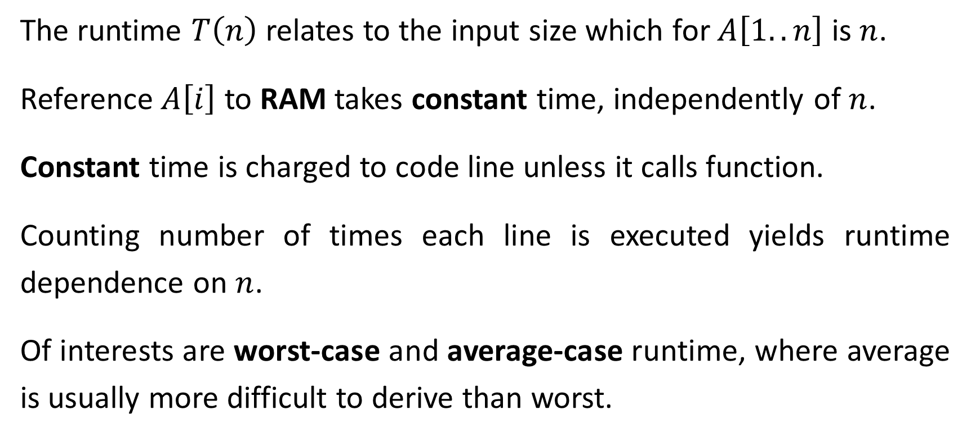
Runtime Analysis
The runtime $T\left(n\right)$ relates to the input size which for $A\left[1..n\right]$ is $n$.
Reference $A\left[i\right]$ to RAM takes constant time, independently of $n$.
Constant time is charged to code line unless it calls function.
Counting number of times each line is executed yields runtime dependence on $n$.
Of interests are worst-case and average-case runtime, where average is usually more difficult to derive than worst.

Slide 6
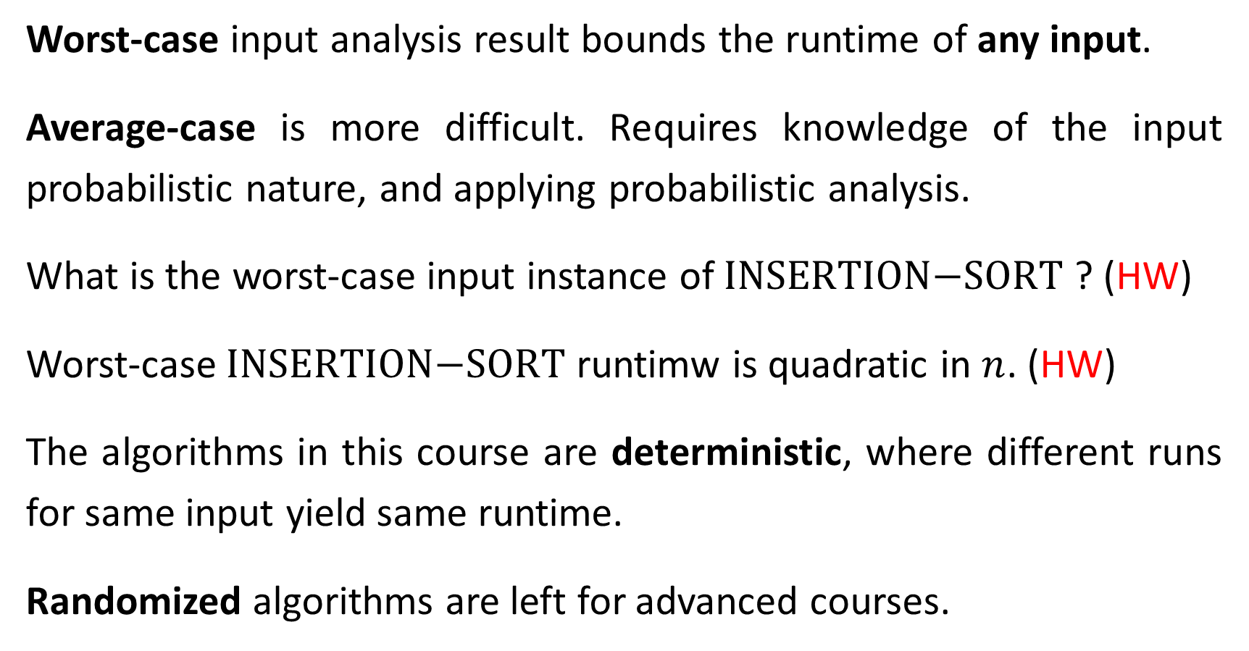
Worst-case input analysis result bounds the runtime of any input.
Average-case is more difficult. Requires knowledge of the input probabilistic nature, and applying probabilistic analysis.
What is the worst-case input instance of $\text{INSERTION}\text{−}\text{SORT}$ ? (HW)
Worst-case $\text{INSERTION}\text{−}\text{SORT}$ runtimw is quadratic in $n$. (HW)
The algorithms in this course are deterministic, where different runs for same input yield same runtime.
Randomized algorithms are left for advanced courses.

Slide 7
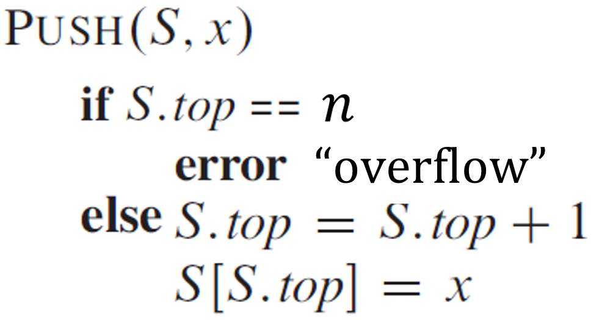
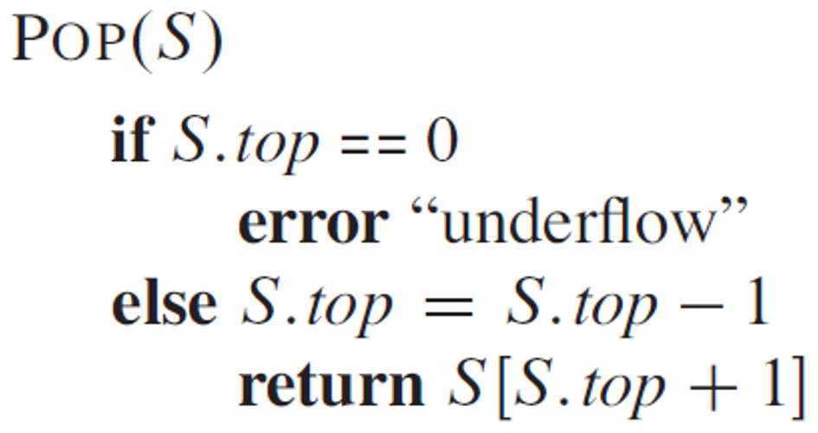
Stacks
Dynamic set where elements are deleted in last-in, first-out (LIFO).
INSERT operation is called PUSH, DELETE operation is called POP.

Slide 8












$$S.top=4$$
$$1$$ | $$2$$ | $$3$$ | $$4$$ | $$5$$ | $$6$$ | $$7$$
$$\text{PUSH}(S,v)$$
$$b$$ | $$z$$ | $$r$$ | $$m$$
$$\text{PUSH}(S,t)$$
$$S.top=6$$
$$1$$ | $$2$$ | $$3$$ | $$4$$ | $$5$$ | $$6$$ | $$7$$
$$\text{P}\text{OP}(S)$$
$$b$$ | $$z$$ | $$r$$ | $$m$$ | $$v$$ | $$t$$
$$S.top=5$$
$$1$$ | $$2$$ | $$3$$ | $$4$$ | $$5$$ | $$6$$ | $$7$$
$$b$$ | $$z$$ | $$r$$ | $$m$$ | $$v$$

Slide 9









































































Queues
Dynamic set. Elements deleted in a first-in, first-out (FIFO).
INSERT called ENQUEUE, DELETE is called DEQUEUE. (code CLRS 10.1)
Queue has head and tail. Insertion is made to tail, deletion to head.
3 x ENQUEUE
2 x DEQUEUE
$$\text{tail}$$
$$16$$
$$1$$
$$16$$
$$1$$
$$16$$
$$1$$
$$15$$
$$2$$
$$15$$
$$2$$
$$15$$
$$2$$
$$z$$
$$d$$
$$\text{tail}$$
$$z$$
$$d$$
$$\text{tail}$$
$$14$$
$$w$$
$$3$$
$$14$$
$$w$$
$$t$$
$$3$$
$$14$$
$$w$$
$$t$$
$$3$$
$$m$$
$$m$$
$$\text{head}$$
$$m$$
$$13$$
$$r$$
$$4$$
$$13$$
$$r$$
$$4$$
$$13$$
$$r$$
$$4$$
$$p$$
$$p$$
$$12$$
$$5$$
$$12$$
$$5$$
$$12$$
$$5$$
$$b$$
$$b$$
$$11$$
$$6$$
$$11$$
$$6$$
$$11$$
$$6$$
$$\text{head}$$
$$\text{head}$$
$$10$$
$$7$$
$$10$$
$$7$$
$$10$$
$$7$$
$$9$$
$$8$$
$$9$$
$$8$$
$$9$$
$$8$$

Slide 10
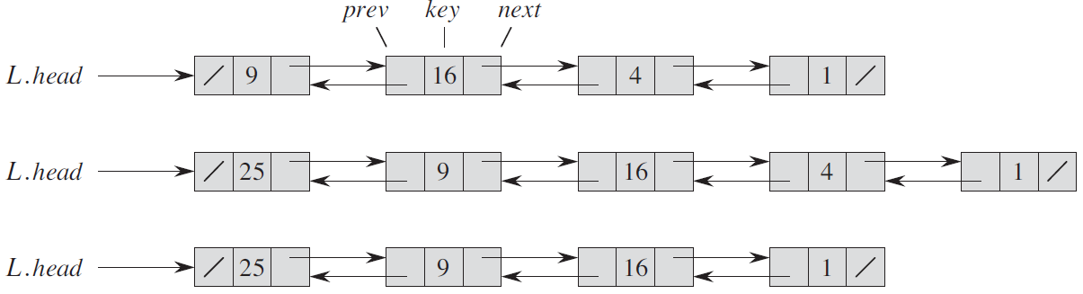
Linked Lists
Data structure where objects ordered linearly.
Unlike arrays which size is predefined, linked lists size change dynamically by using pointers (memory addresses) attached to objects.
Insert object at head
Delete object

Slide 11
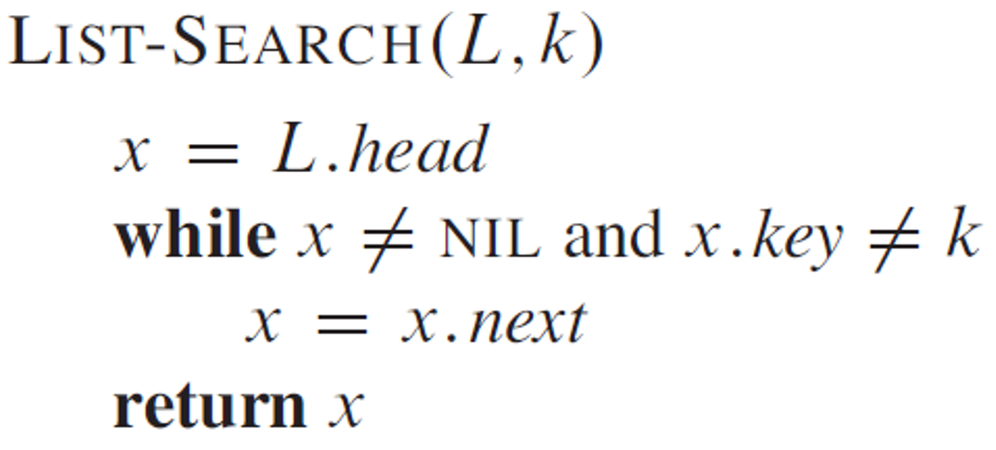
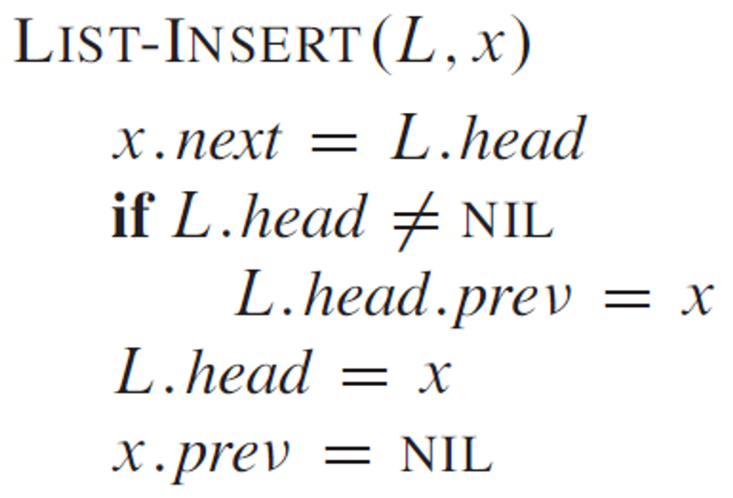
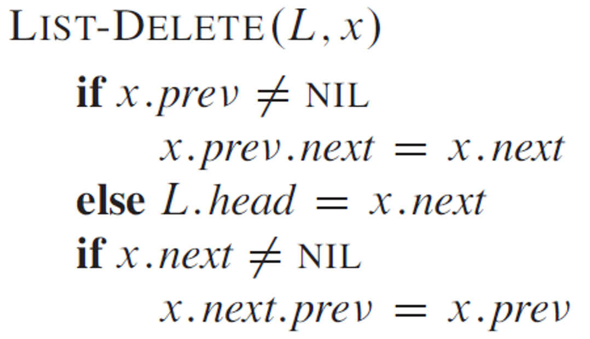

Slide 12
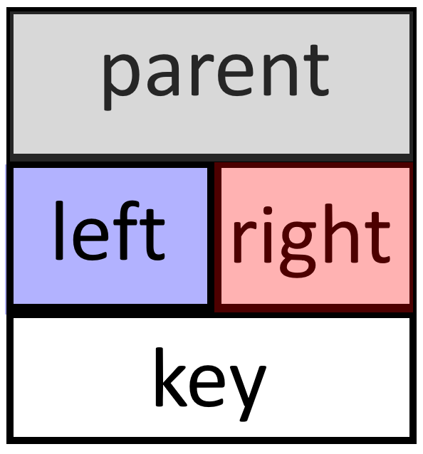





Rooted Trees Representation
Linked lists representation is generalized for rooted trees.
$$T.root$$
$$pointer$$
$$pointer$$
$$pointer$$
$$value$$

Slide 13

$$T.root$$
Three pointers at node are sufficient so all children can be reached in time linear in the number of children.

Slide 14
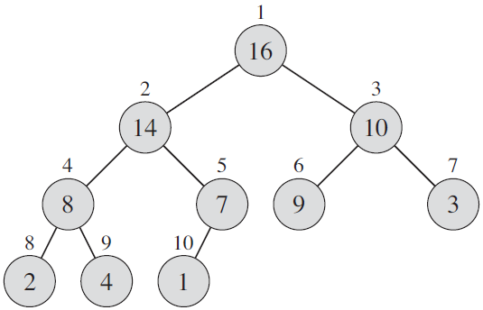
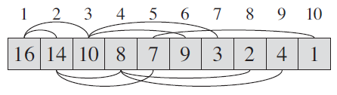
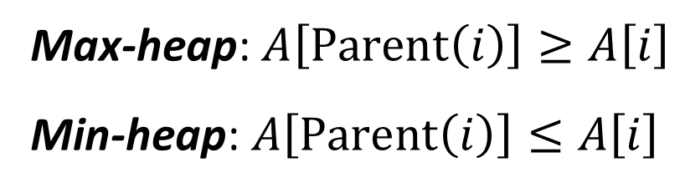
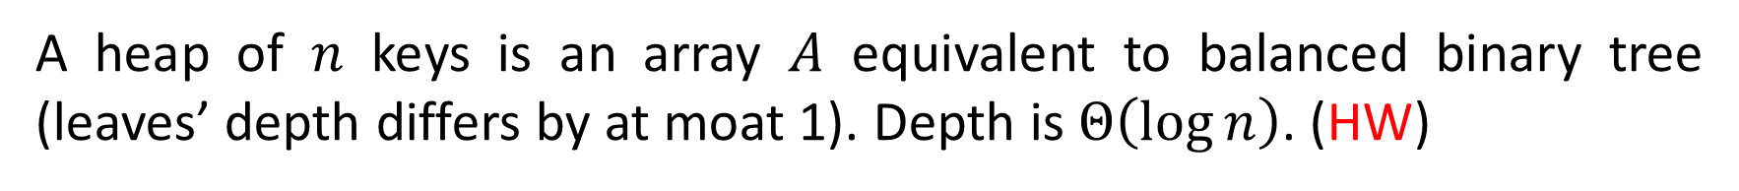
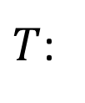
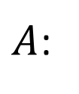
Heaps
A heap of $n$ keys is an array $A$ equivalent to balanced binary tree (leaves’ depth differs by at moat 1). Depth is $Θ\left(\log{n}\right)$. (HW)
$\text{Parent}\left(i\right)=\left\lfloor i/2\right\rfloor$, $\text{Left}\left(i\right)=2i$, $\text{Right}\left(i\right)=2i+1$, hardware efficient.
$A$:
$T$:
Max-heap: $A\left[\text{Parent}\left(i\right)\right]≥A\left[i\right]$
Min-heap: $A\left[\text{Parent}\left(i\right)\right]≤A\left[i\right]$

Slide 15
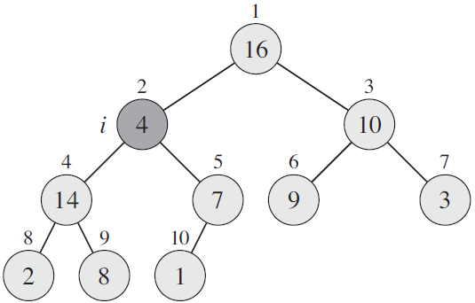
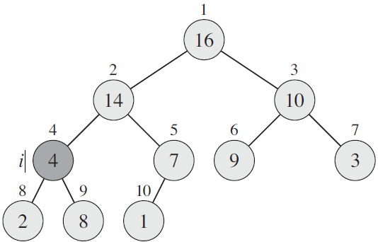
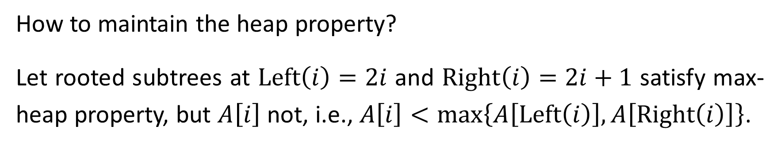
How to maintain the heap property?
Let rooted subtrees at $\text{Left}\left(i\right)=2i$ and $\text{Right}\left(i\right)=2i+1$ satisfy max-heap property, but $A\left[i\right]$ not, i.e., $A\left[i\right]<\max\left\{A\left[\text{Left}\left(i\right)\right],A\left[\text{Right}\left(i\right)\right]\right\}$.
violation
violation
compete
compete

Slide 16
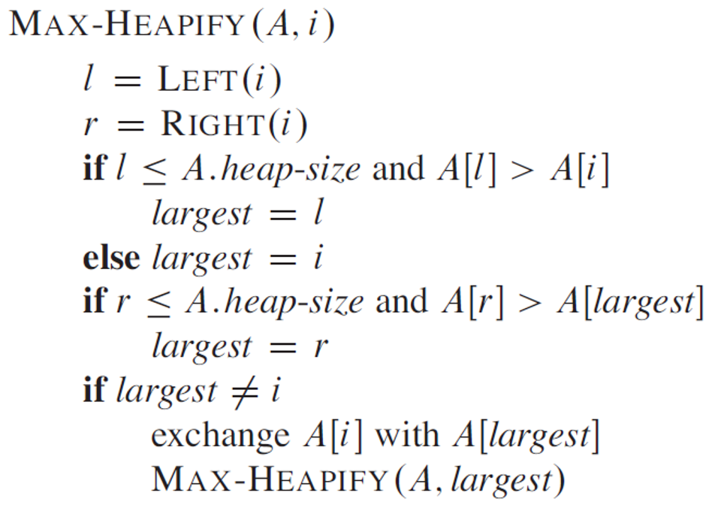
// left son exists?
// left son beats parent
// right son exists?
// right son beats parent and left
// downshift parent
// proceed recursively

Slide 17
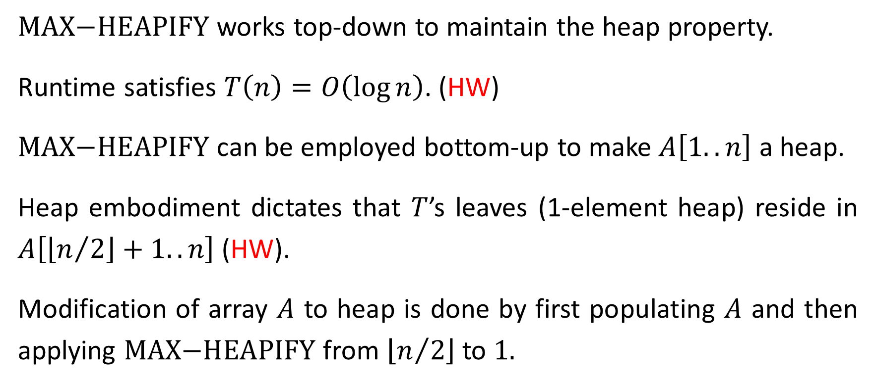
$\text{MAX}\text{−}\text{HEAPIFY}$ works top-down to maintain the heap property.
Runtime satisfies $T\left(n\right)=O\left(\log{n}\right)$. (HW)
$\text{MAX}\text{−}\text{HEAPIFY}$ can be employed bottom-up to make $A\left[1..n\right]$ a heap.
Heap embodiment dictates that $T$’s leaves (1-element heap) reside in $A\left[\left\lfloor n/2\right\rfloor +1..n\right]$ (HW).
Modification of array $A$ to heap is done by first populating $A$ and then applying $\text{MAX}\text{−}\text{HEAPIFY}$ from $\left\lfloor n/2\right\rfloor$ to $1.$

Slide 18
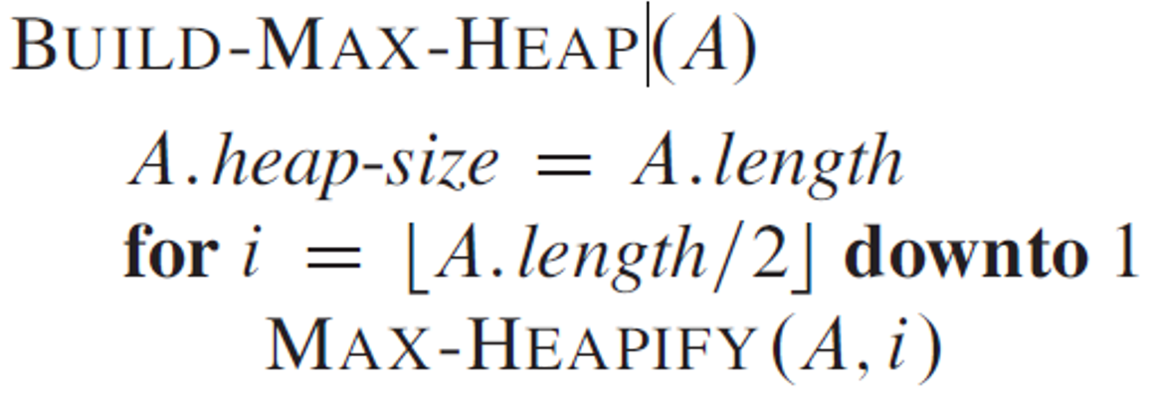
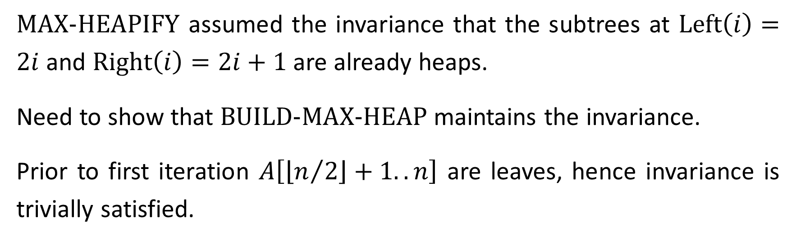
$\text{MAX}\text{−}\text{HEAPIFY}$ assumed the invariance that the subtrees at $\text{Left}\left(i\right)=2i$ and $\text{Right}\left(i\right)=2i+1$ are already heaps.
Need to show that $\text{BUILD}\text{−}\text{MAX}\text{−}\text{HEAP}$ maintains the invariance.
Prior to first iteration $A\left[\left\lfloor n/2\right\rfloor +1..n\right]$ are leaves, hence invariance is trivially satisfied.

Slide 19
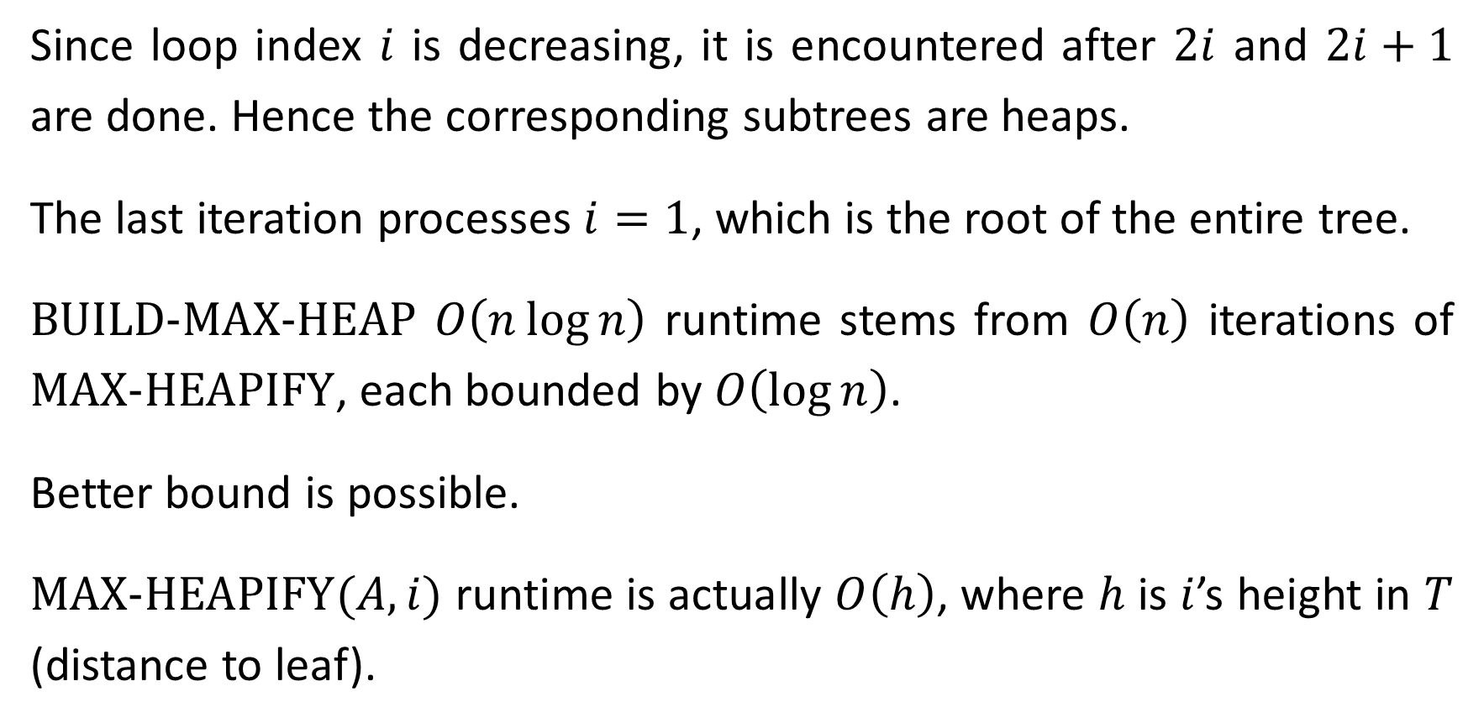
Since loop index $i$ is decreasing, it is encountered after $2i$ and $2i+1$ are done. Hence the corresponding subtrees are heaps.
The last iteration processes $i=1$, which is the root of the entire tree.
$\text{BUILD}\text{−}\text{MAX}\text{−}\text{HEAP}$ $O\left(n\log{n}\right)$ runtime stems from $O\left(n\right)$ iterations of $\text{MAX}\text{−}\text{HEAPIFY}$, each bounded by $O\left(\log{n}\right)$.
Better bound is possible.
$\text{MAX}\text{−}\text{HEAPIFY}(A,i)$ runtime is actually $O\left(h\right)$, where $h$ is $i$’s height in $T$ (distance to leaf).

Slide 20
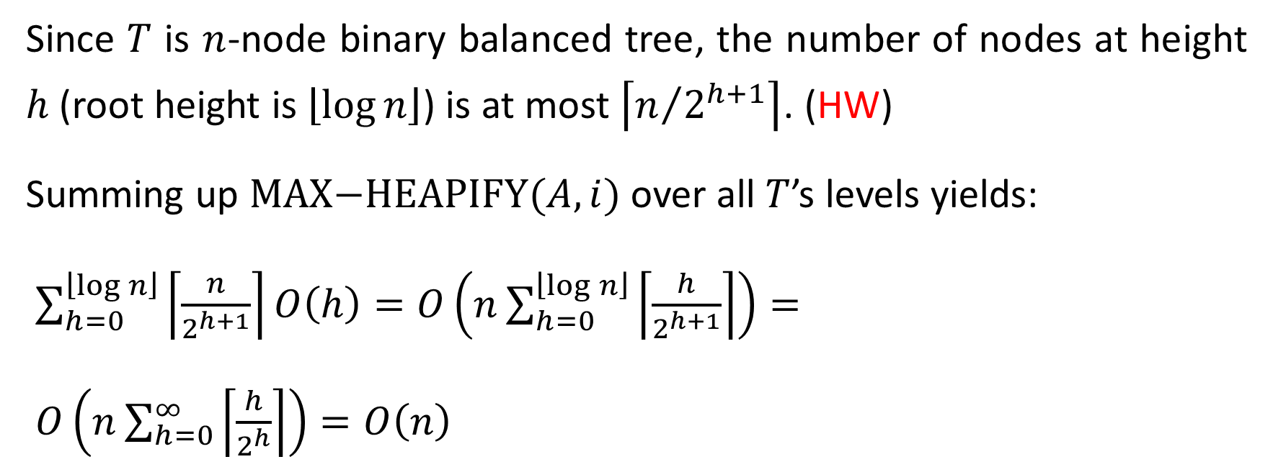
Since $T$ is $n$-node binary balanced tree, the number of nodes at height $h$ (root height is $\left\lfloor \log{n}\right\rfloor$) is at most $\left\lceil n/{2^{h+1}}\right\rceil$. (HW)
Summing up $\text{MAX}\text{−}\text{HEAPIFY}(A,i)$ over all $T$’s levels yields:
$\sum_{h=0}^{\left\lfloor \log{n}\right\rfloor }{\left\lceil \frac{n}{2^{h+1}}\right\rceil }O\left(h\right)=O\left(n\sum_{h=0}^{\left\lfloor \log{n}\right\rfloor }{\left\lceil \frac{h}{2^{h+1}}\right\rceil }\right)=$
$O\left(n\sum_{h=0}^{∞}{\left\lceil \frac{h}{2^{h}}\right\rceil }\right)=O\left(n\right)$
$$\text{for} \left|x\right|<1, \sum_{h=0}^{∞}{x^{h}}=\frac{1}{1−x}\text{, }\text{drivate}⇒\sum_{h=0}^{∞}{{hx}^{h−1}}=\frac{1}{{\left(1−x\right)}^{2}}$$

Slide 21
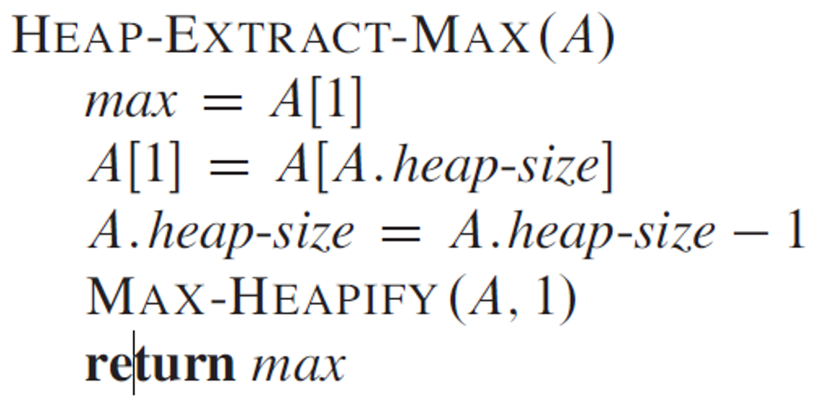
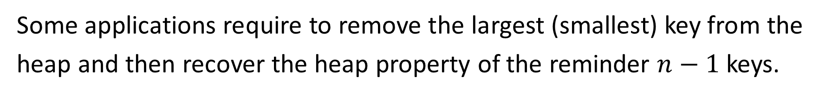
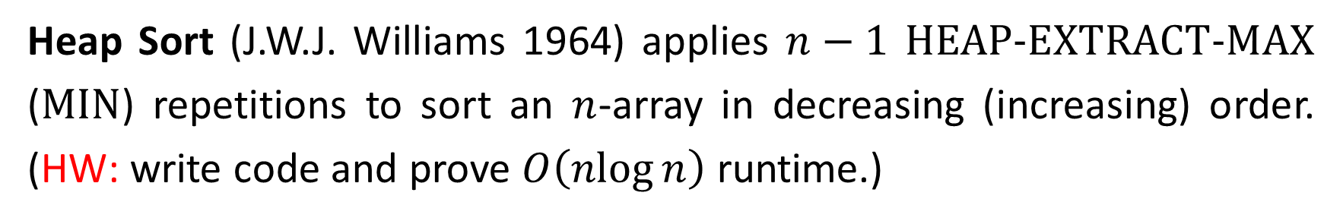
Heap Sort
Some applications require to remove the largest (smallest) key from the heap and then recover the heap property of the reminder $n−1$ keys.
// largest key is the 1st
// fill in the vacant location
// decrease heap size
// recover heap property
Heap Sort (J.W.J. Williams 1964) applies $n−1$ $\text{HEAP}\text{−}\text{EXTRACT}\text{−}\text{MAX}$ ($\text{MIN}$) repetitions to sort an $n$-array in decreasing (increasing) order. (HW: write code and prove $O\left(\operatorname{nlog}{n}\right)$ runtime.)

